Slide 1
Understanding the role of global food trade on the transmission dynamics of antibiotic-resistant foodborne bacteria
Alex Morgan

Slide 2
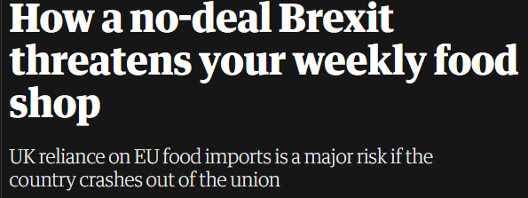
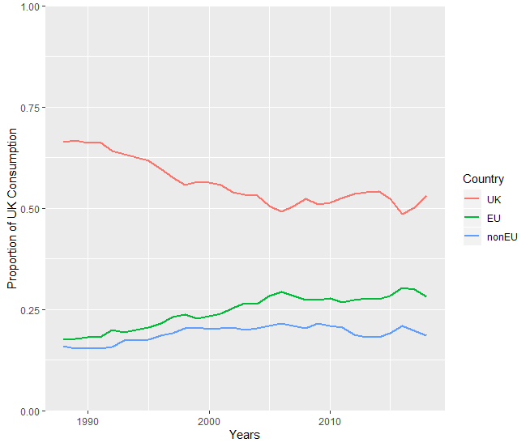
Introduction
FSA (2016) – Systematic Review of AMR bacteria in food at UK retail:
“There is a need for more studies to quantify the contribution of both domestic and imported foods to AMR occurrence…”
Could imported food products contribute to AMR in humans or disrupt one health interventions?
Notes:
https://www.food.gov.uk/research/foodborne-diseases/a-systematic-review-of-amr-bacteria-in-pork-poultry-dairy-products-seafood-and-fresh-produce-at-uk-retail-level
The figures show that over the last few decades UK consumption of domestic origin food products has been decreasing, with steady increases in the use of EU food products and a small increases in the use of non-EU food products.
For the usage parameter - it would be accurate to use the current plateau in the domestic food usage we have seen over the past few years (2005-2018).
DEFRA data for UK food origin of domestic consumption

Slide 3
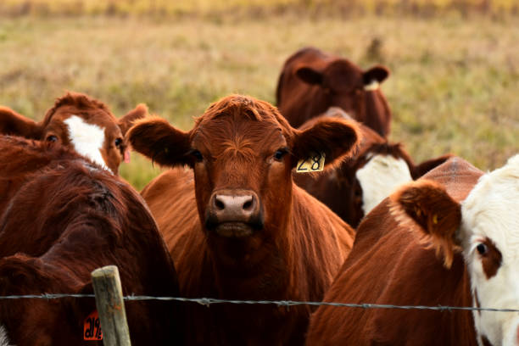



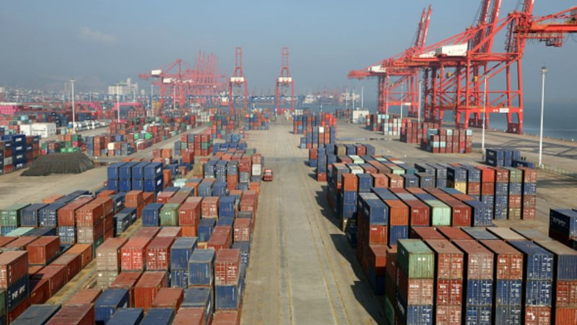
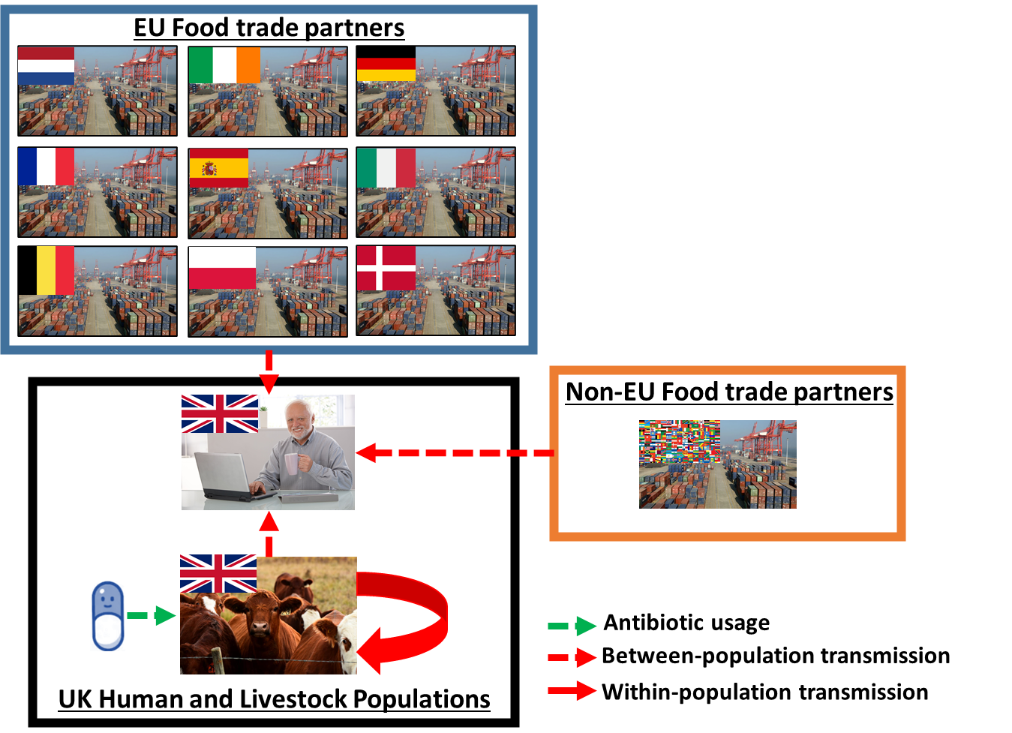
Hypothesis
Classic one health AMR intervention…
Reduce livestock antibiotic usage to reduce human AMR.
Local livestock interventions may potentially become “saturated” by AMR pressure from other sources (imported food?).
Can AMR on imported food products affect local AMR interventions?
Domestic
Livestock
Resistance
Humans
Imported
Food
Notes:
https://www.food.gov.uk/research/foodborne-diseases/a-systematic-review-of-amr-bacteria-in-pork-poultry-dairy-products-seafood-and-fresh-produce-at-uk-retail-level
The figures show that over the last few decades UK consumption of domestic origin food products has been decreasing, with steady increases in the use of EU food products and a small increases in the use of non-EU food products.
For the usage parameter - it would be accurate to use the current plateau in the domestic food usage we have seen over the past few years (2005-2018).
DEFRA data for UK food origin of domestic consumption

Slide 4
Aims
Chapter Aim:
Understand how importation of food products can affect local human AMR dynamics and livestock interventions…
Part 1 – How important is AMR on imported food products?
Part 2 – How does imported AMR affect interventions in a “realistic” heterogeneous trade network?

Slide 5
Methods – Part 1
Non-UK Food Import
“Simple” model
Treats imported food as a separate but homogenous source of transmission
Explores the general influence of import in a livestock/human transmission model
Specifically on the effect of livestock curtailment interventions
Livestock interventions only affect DOMESTIC livestock
UK Human and Livestock Populations
Antibiotic Usage
Population-level transmission
Within-population transmission

Slide 6
Methods – Part 2
“Complex” model
Stratifies the imported food into individual countries with specific levels of contamination and resistance
Explores the effect of greater levels of heterogeneity in import pressure compared to the previous model

Slide 7
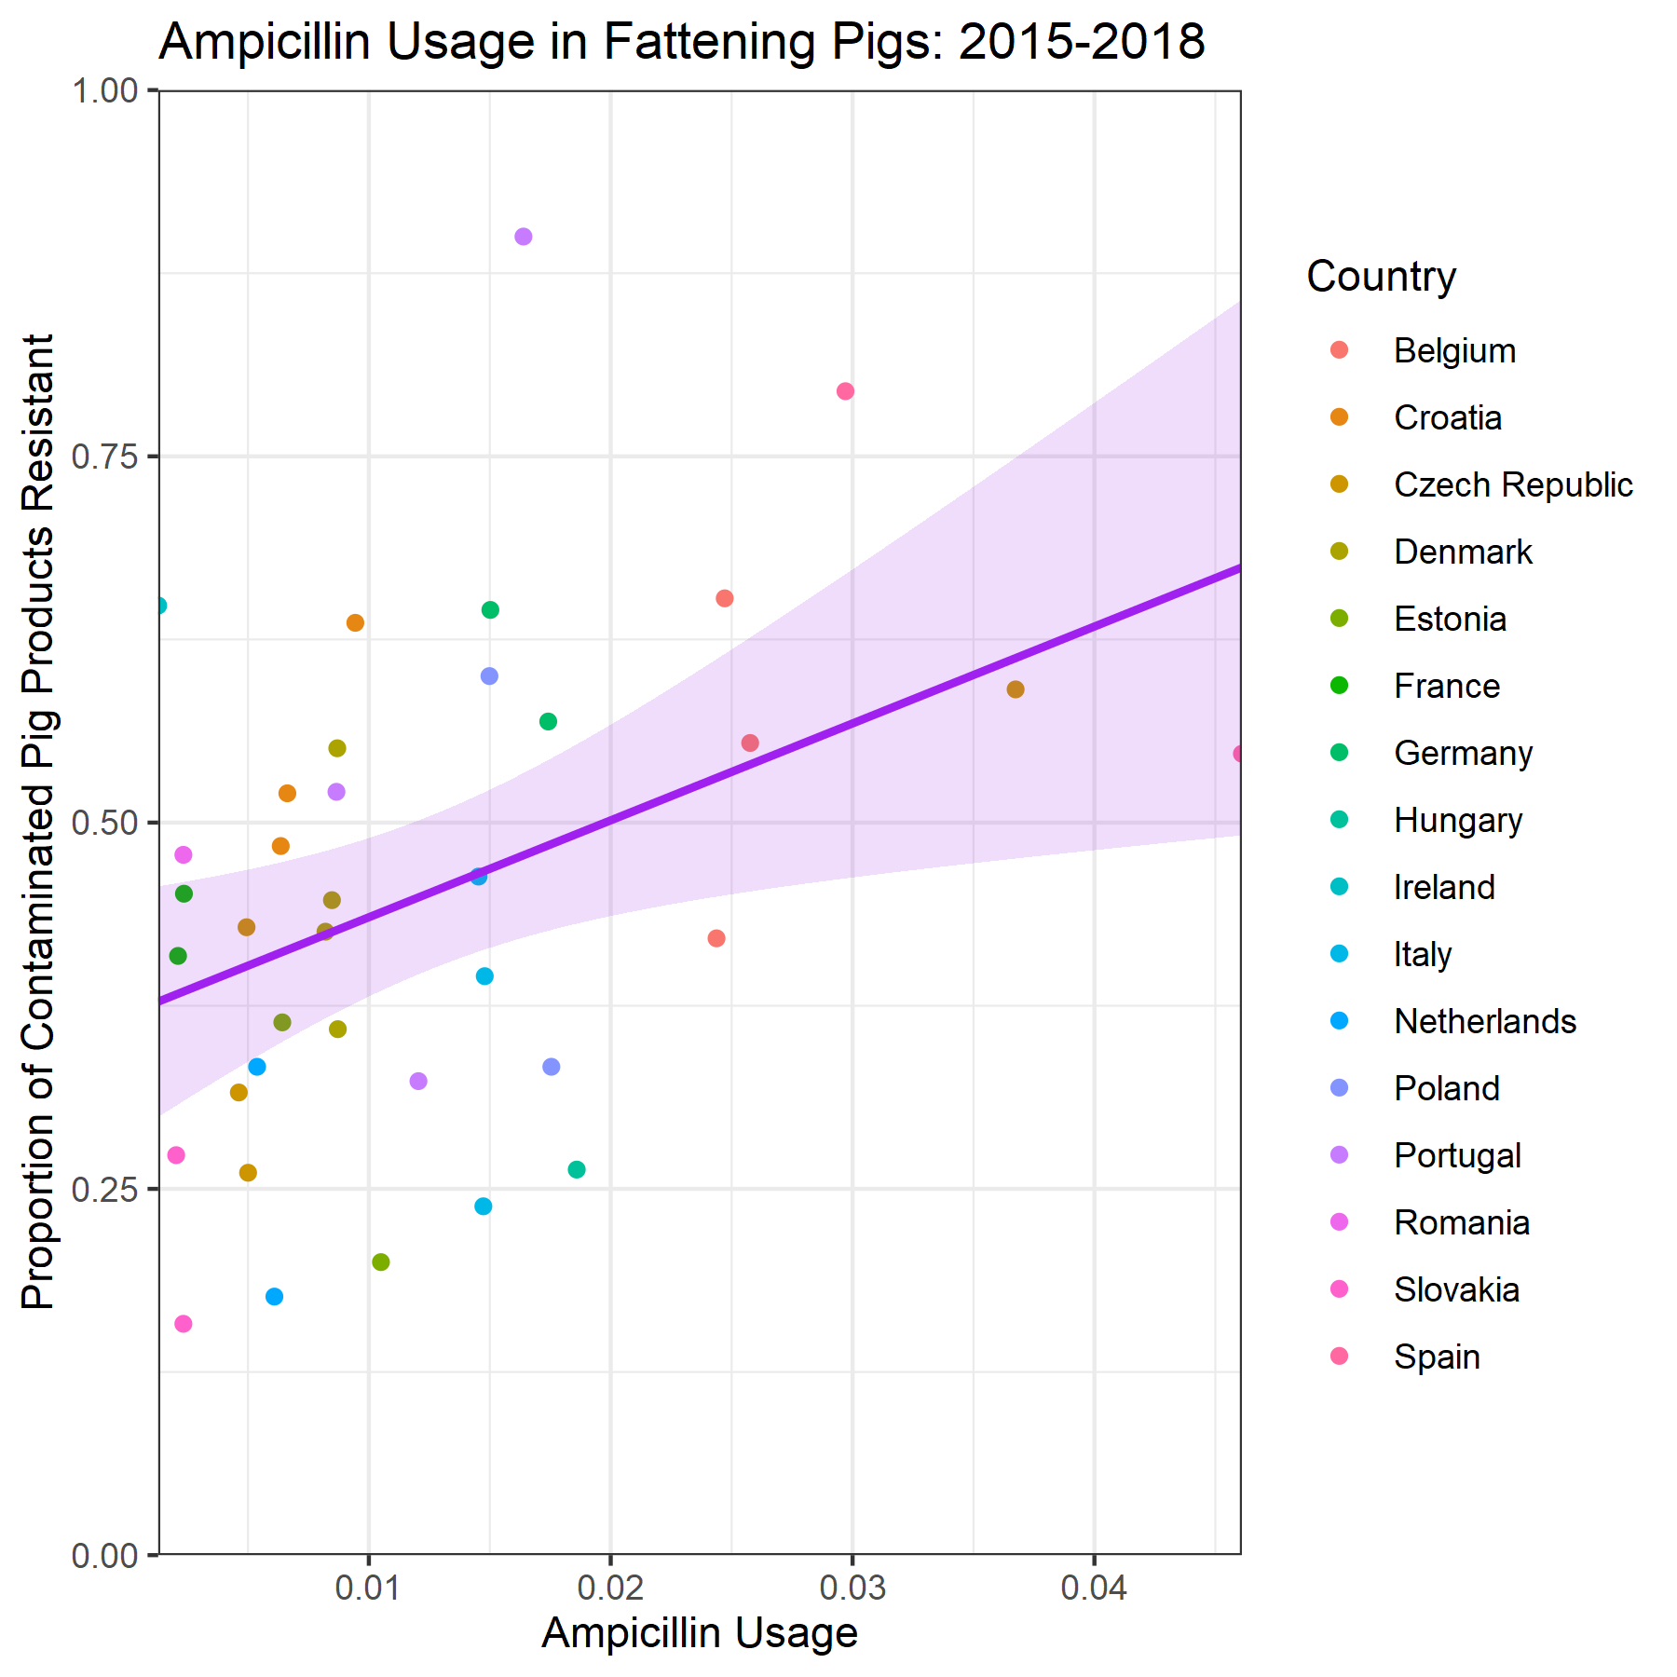
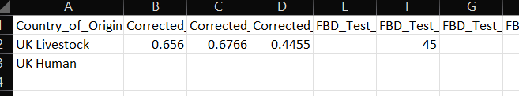
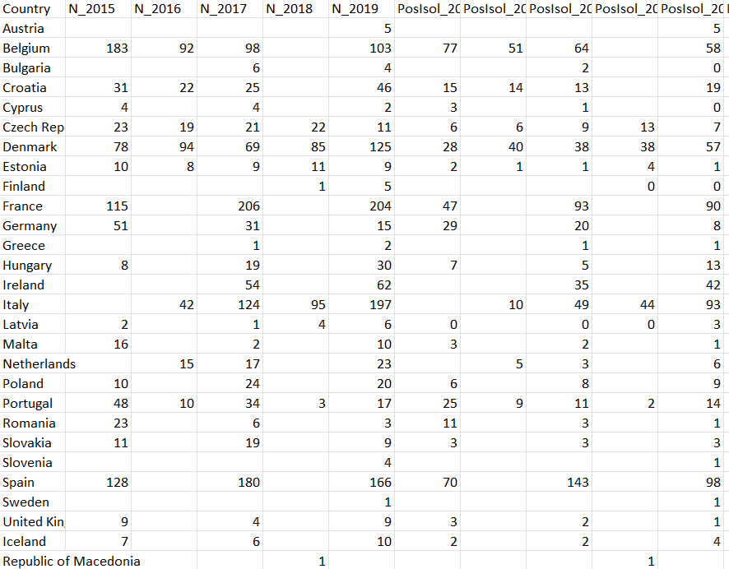
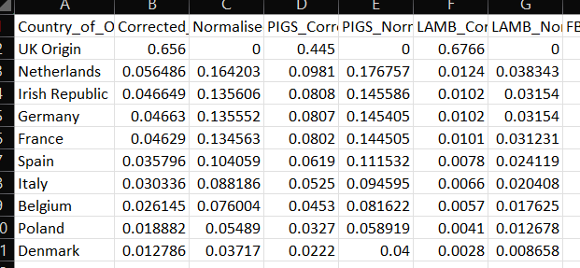
Methods – Datasets
3 Datasets are required
UK Specific Parameterisation
General Resistance/Usage Dataset
Import Parameterisation
Outcome Measures to Fit
Relationship between antibiotic usage and resistance (general)
Part 2 Model – contamination and resistance in imported food products (Import)
Specific and general
UK Human foodborne disease and resistance (UK)
UK Livestock foodborne contamination and resistance (UK)
(Coefficient = 6.61, p = 0.0145)
Use approximate Bayesian computation (sequential monte carlo) – ABC-SMC - model fitting to ensure that model is fitted to ampicillin-resistance in fattening pigs case study

Slide 8
IMP_{SA} = (1-Proportion of Imports Resistant)*Proportion of Import Contaminated
r_{A}
I_{SH}
μ_{H}
τ
ηψβ_{HA}
(1-ψ)β_{HA}
IMP_{SA}
I_{SA}
μ_{A}
½ ζ
r_{H}
β_{AA}
S_{A}
S_{H}
μ_{A}
φ
τθ
μ_{H}
μ_{H}
μ_{A}
IMP_{RA} = Proportion of Imports Resistant*Proportion of Import Contaminated
αβ_{AA}
½αζ
I_{RA}
r_{H}
μ_{A}
IMP_{RA}
ηψαβ_{HA}
(1-ψ)αβ_{HA}
I_{RH}
r_{A}
μ_{H}
LIVESTOCK
IMPORTED FOOD
HUMANS

Slide 9
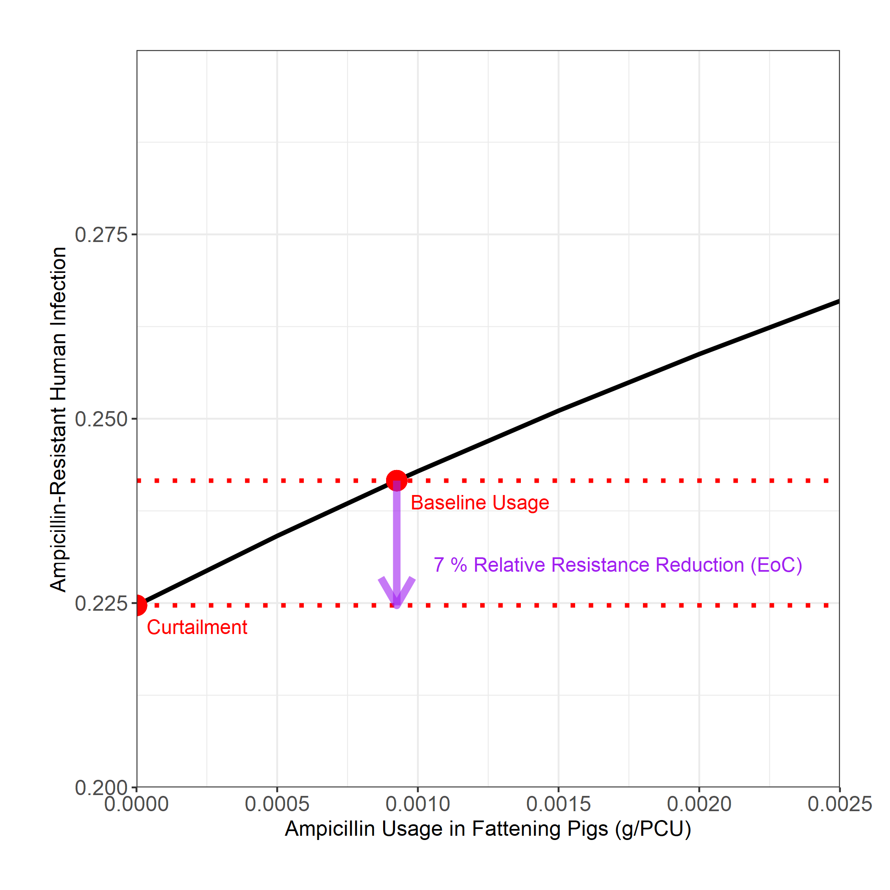
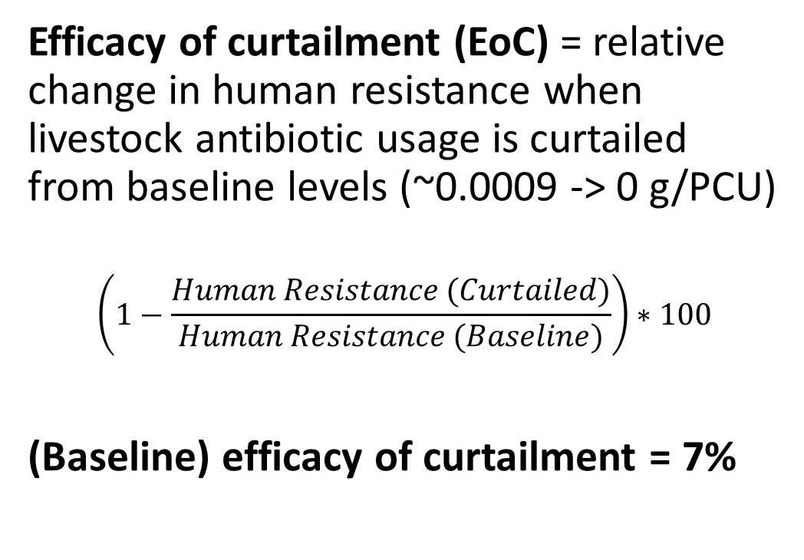
Methods – Outcome Measure
Efficacy of curtailment (EoC) = relative change in human resistance when livestock antibiotic usage is curtailed from baseline levels (~0.0009 -> 0 g/PCU)
$$\left(1−\frac{Human Resistance (Curtailed)}{Human Resistance (Baseline)}\right)∗100$$
(Baseline) efficacy of curtailment = 7%

Slide 10
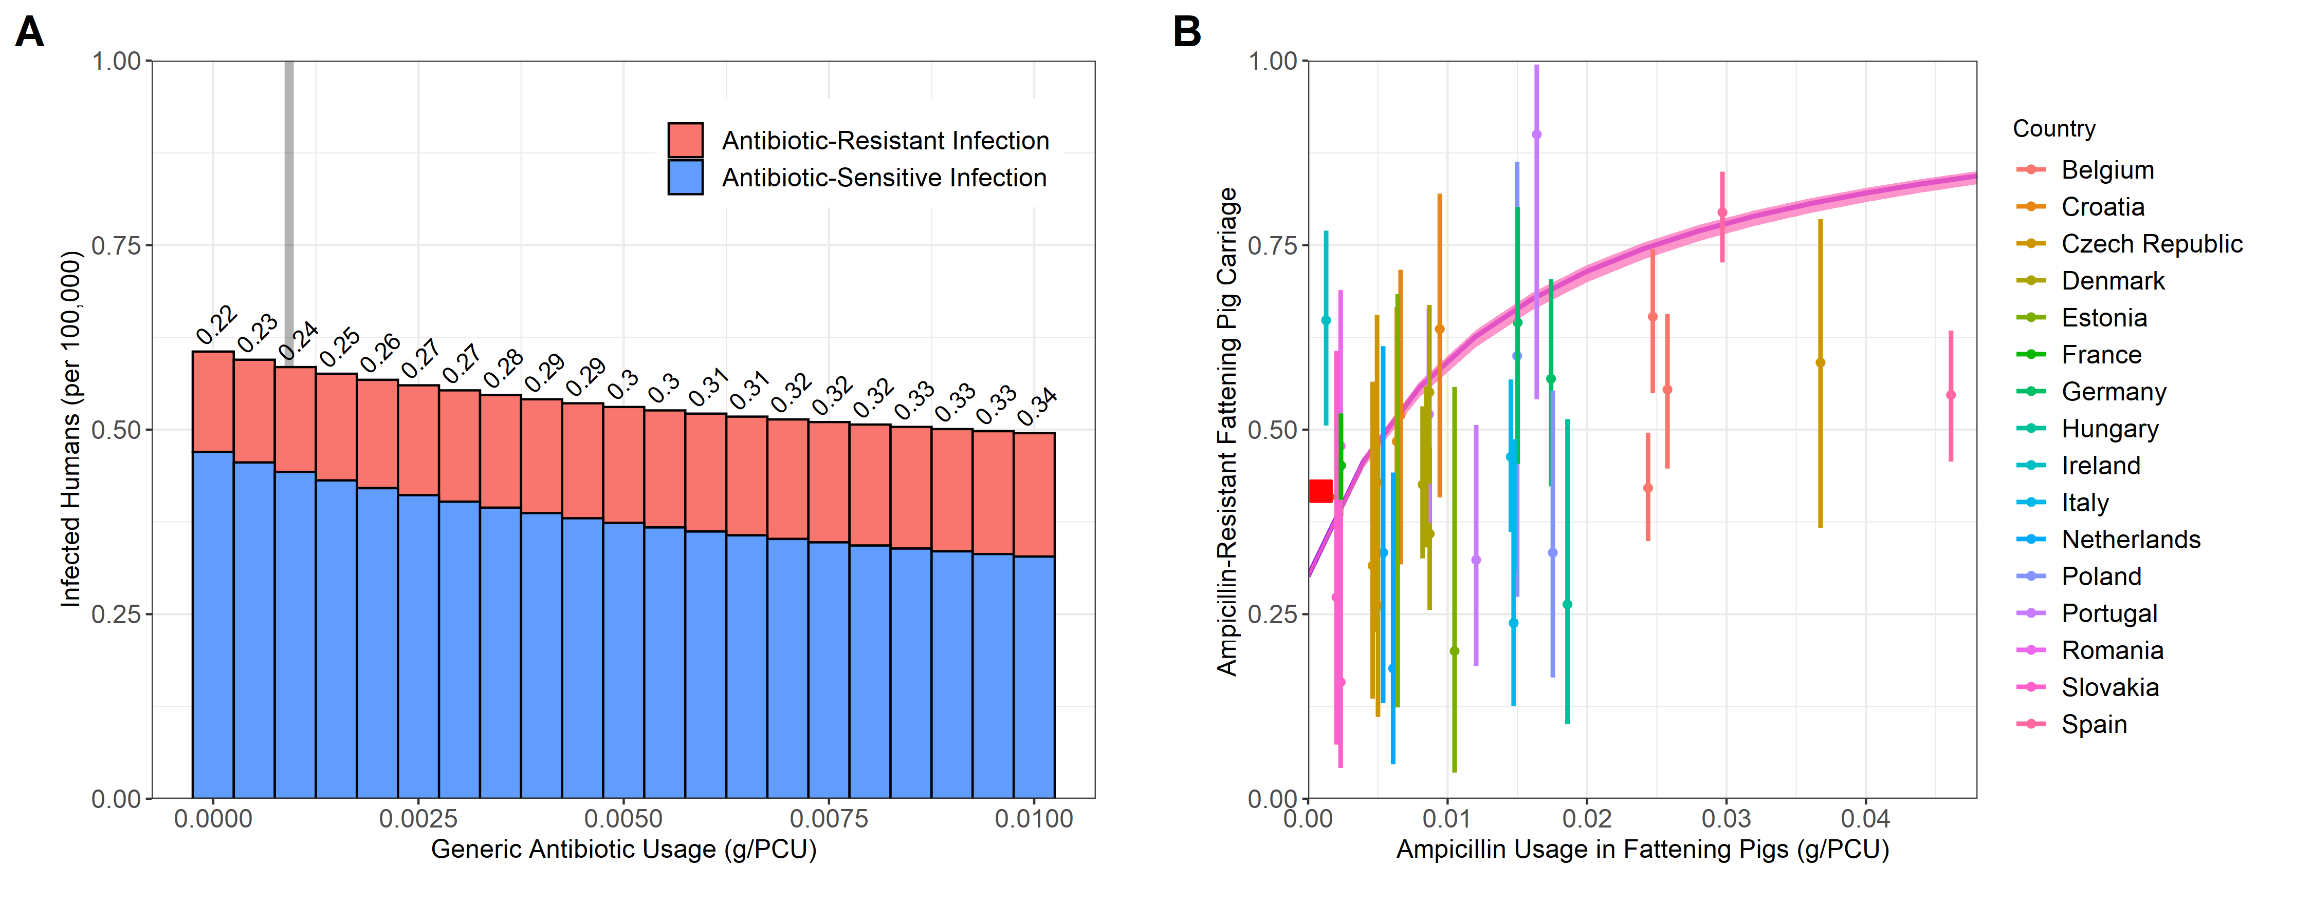
Results – Part 1 Basic Output
We model similar dynamics to the model in Chapter 2 upon livestock antibiotic curtailment:
Small increase in human foodborne disease
Minor reduction in resistance
Distance: 1.71 (Target | Percentage Diff)
Incidence: 0.586 (0.593 | 1.14%)
I_{CombA}: 0.283*0.11016 = 0.0312 (0.0287 | 8.81%)
Human Resistance: 0.242 (0.208 | 16%)
Livestock Resistance: 0.345 (0.417 | 17.13%)

Slide 11
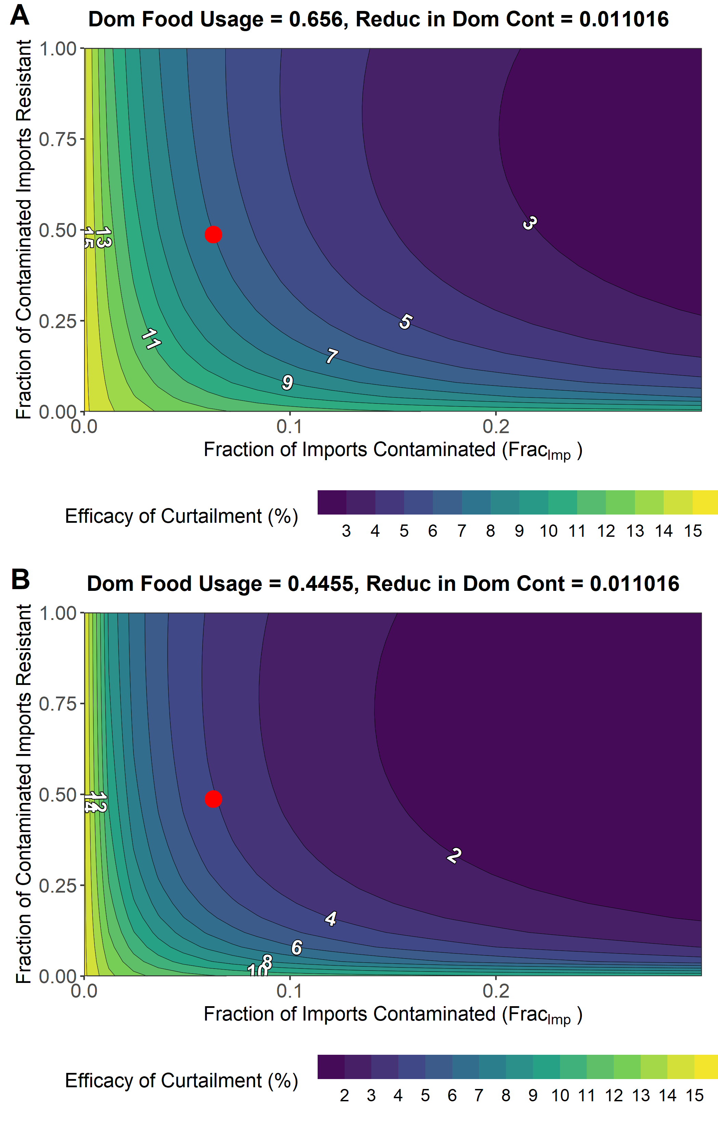
Results – Part 1 Import
We assess the fitted model (ψ = 0.656) and explore the effect of:
Fraction of imported food products contaminated
Fraction of contaminated imports resistant
DARKER – lower efficacy of local antibiotic curtailment
LIGHTER – higher efficacy of local antibiotic curtailment
Compare against alternative case study (ψ = 0.4455) - pig imports.
Increasing imports reduces the ability for curtailment to reduce resistance
Resistance attributable more to imported sources
Notes:
Mention here that the baselines are different (we can’t fit the baseline differently- as other parameters change)
The big take away here is that in the same parameter space – you can’t achieve the same reductions in resistance as you can when domestic usage is a bit higher

Slide 12
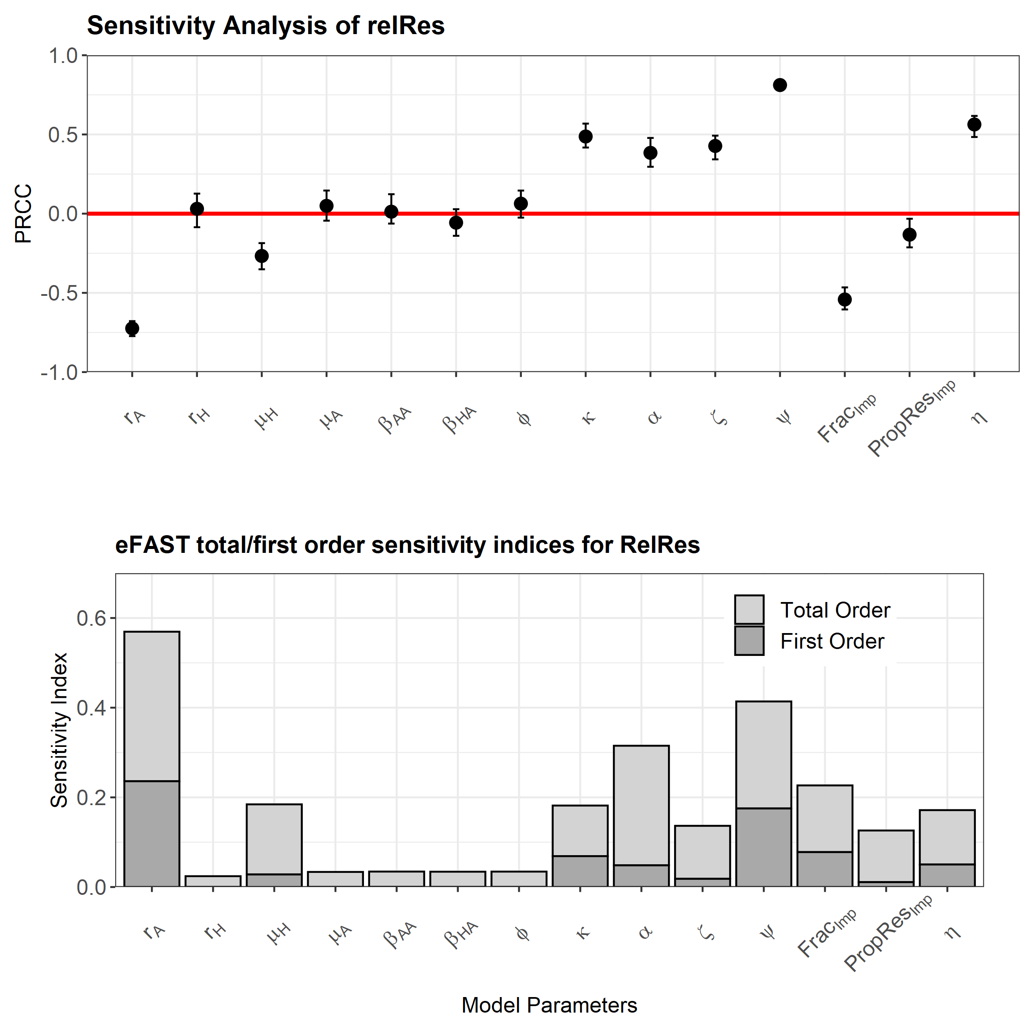
Results – Part 1 Sensitivity Analysis
Latin-hypercube sampling Partial Rank Correlation Coefficient (LHS-PRCC)
Parameter | Parameter Description | Increases do what to Efficacy (EoC)?
ψ | % Domestic Food Usage | INCREASES
Frac_{Imp} | % Imports Contaminated | DECREASES
PropRes_{Imp} | % Cont Imports Resistant | DECREASES
η | Reduction in Prevalence due to food processing | INCREASES
Extended Fourier Amplitude Sensitivity Test (EFAST)
Notes:
Parameters which promote import – will reduce the efficacy of the intervention – betaHD and betaHI and psi
Parameters which promote more contamination on food products will reduce the efficacy of the intervention
We can also see that the majority of these import parameters have a relative high importance on the outcome measure (eFAST) – but a lot of the importance is comprised of interaction effects with other parameters – if the first order effects only comprise a small proportion of the total order effects – then second order or higher order effects are driving most of the variation in the outcome measure.
For example a parameter might interact with another parameter which together will drive a lot of the variation seen in the model outcome measure.
This also makes sense – that they have an interaction effect – because of the multiplicative way I have modelled the import.

Slide 13
Interim Conclusion – Part 1
The model can be fitted to ECDC/EFSA data and UK human outcome measures.
Import reduces attributable resistance from domestic sources – therefore local interventions will have less of an effect.
The extent of domestic food usage (ψ), is important in determining the efficacy of local interventions (EoC).
Parameters which favour import and increase the level of contamination in imported food products will decrease the efficacy of local intervention strategies.

Slide 14
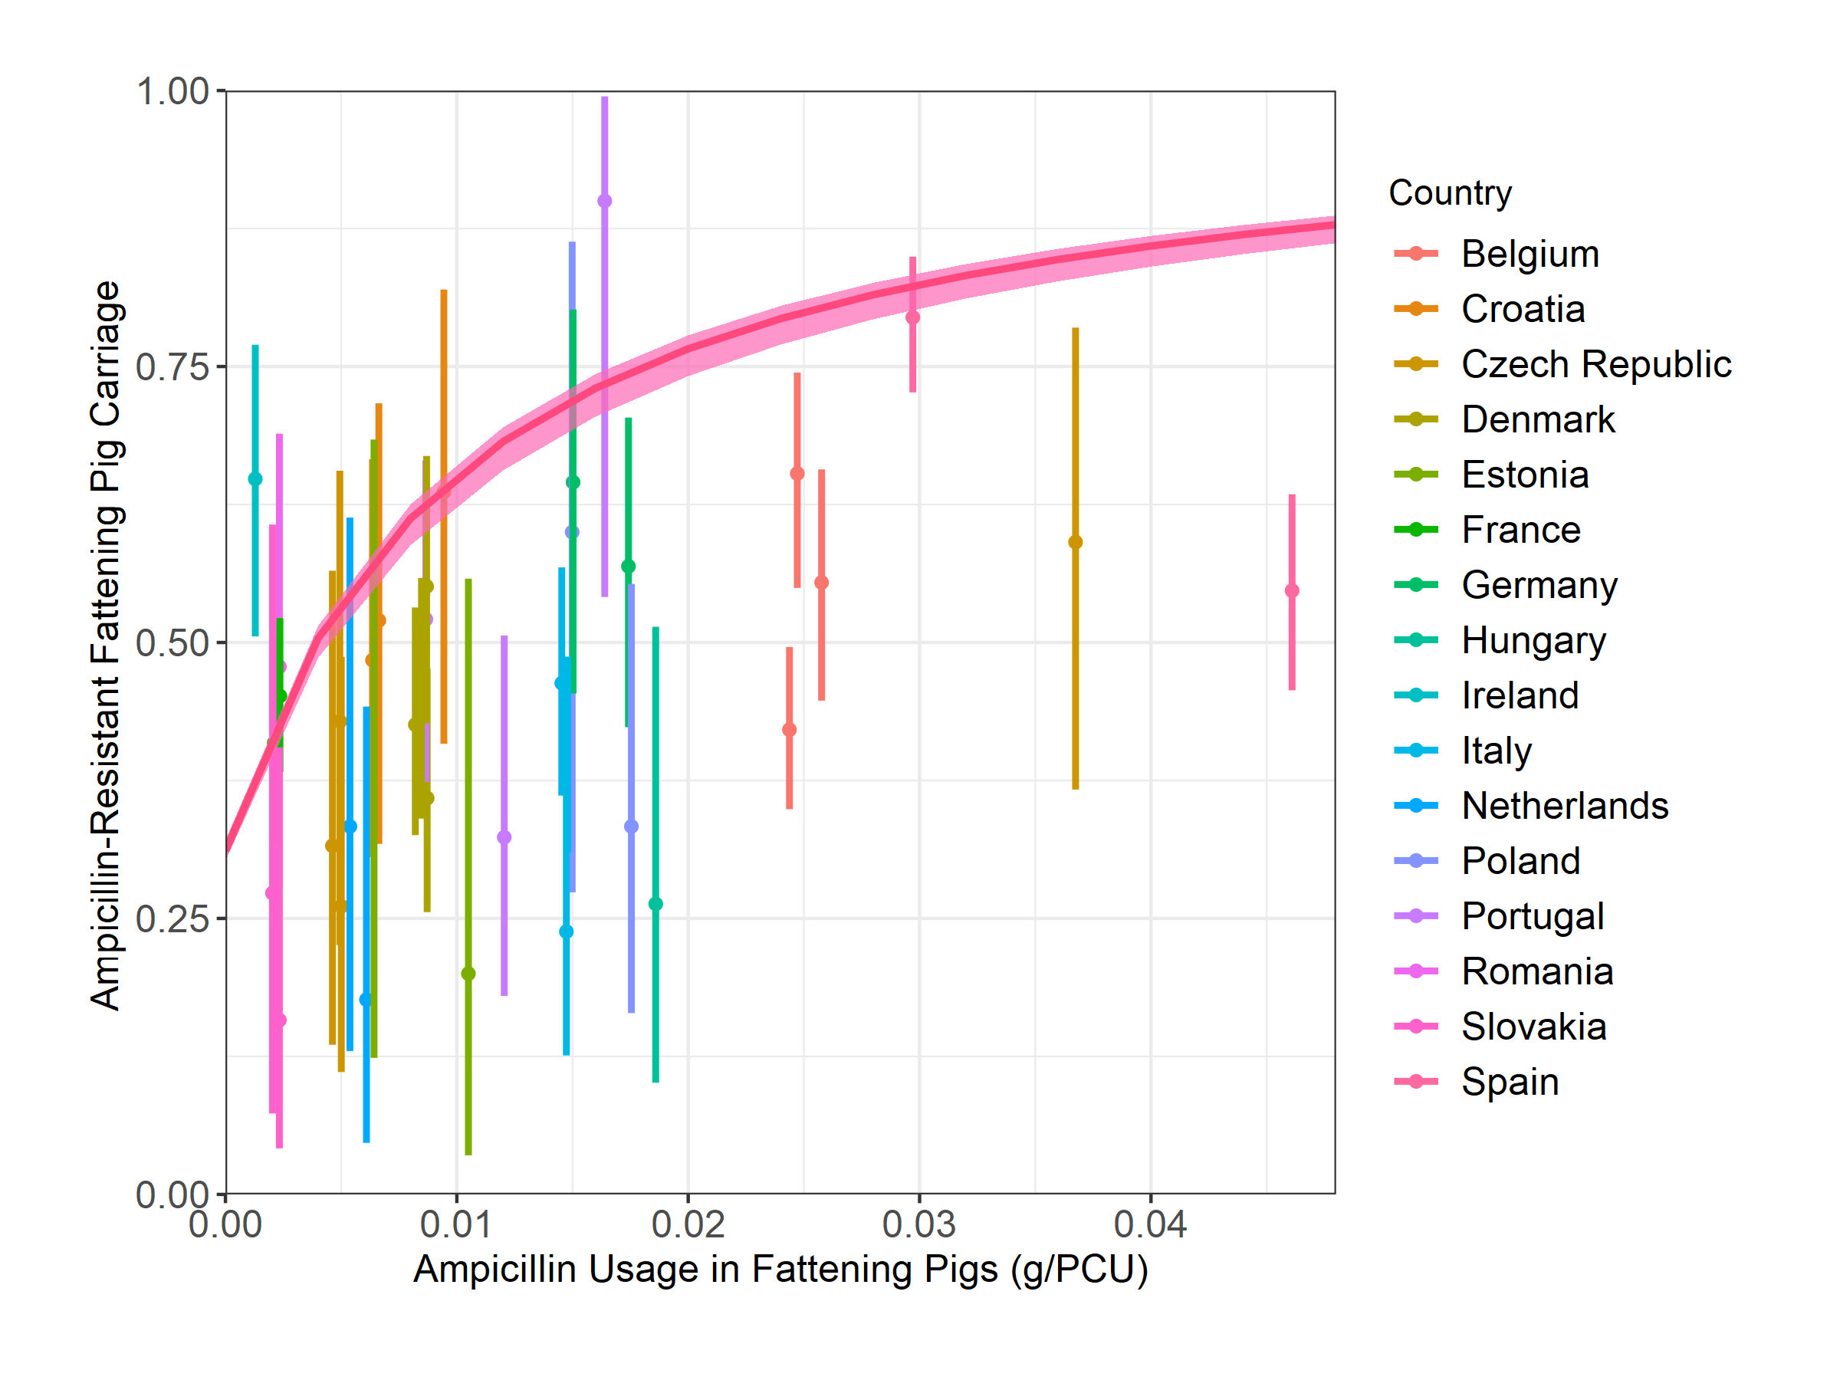
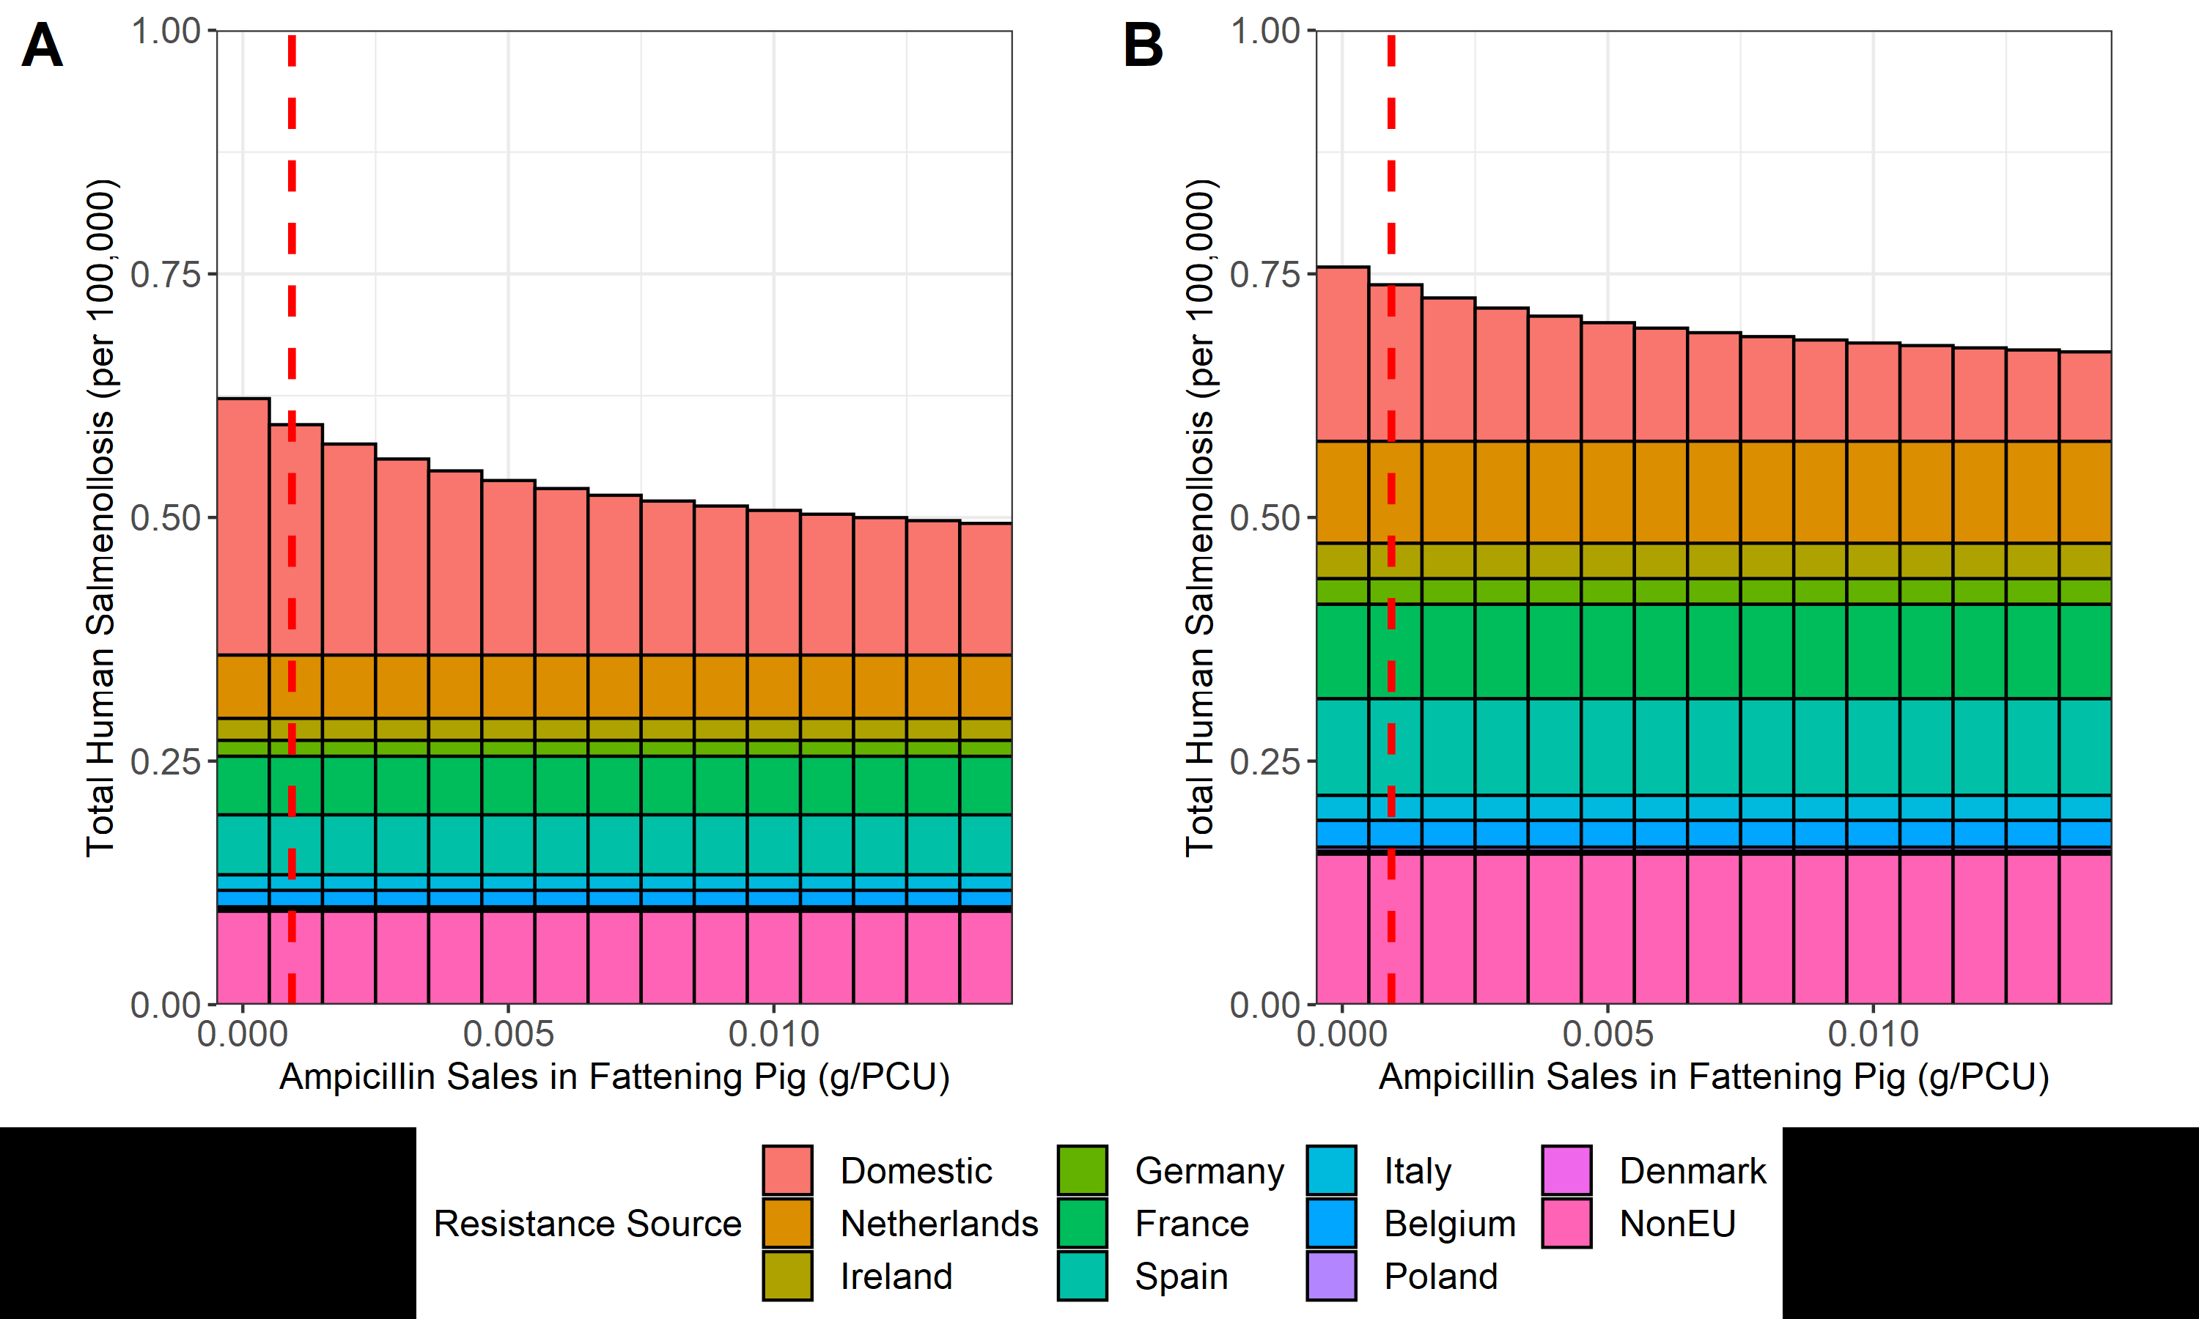
Results – Part 2 Model Fit and Basic Output
% Domestic Food Usage = 0.656
% Domestic Food Usage = 0.455

Slide 15
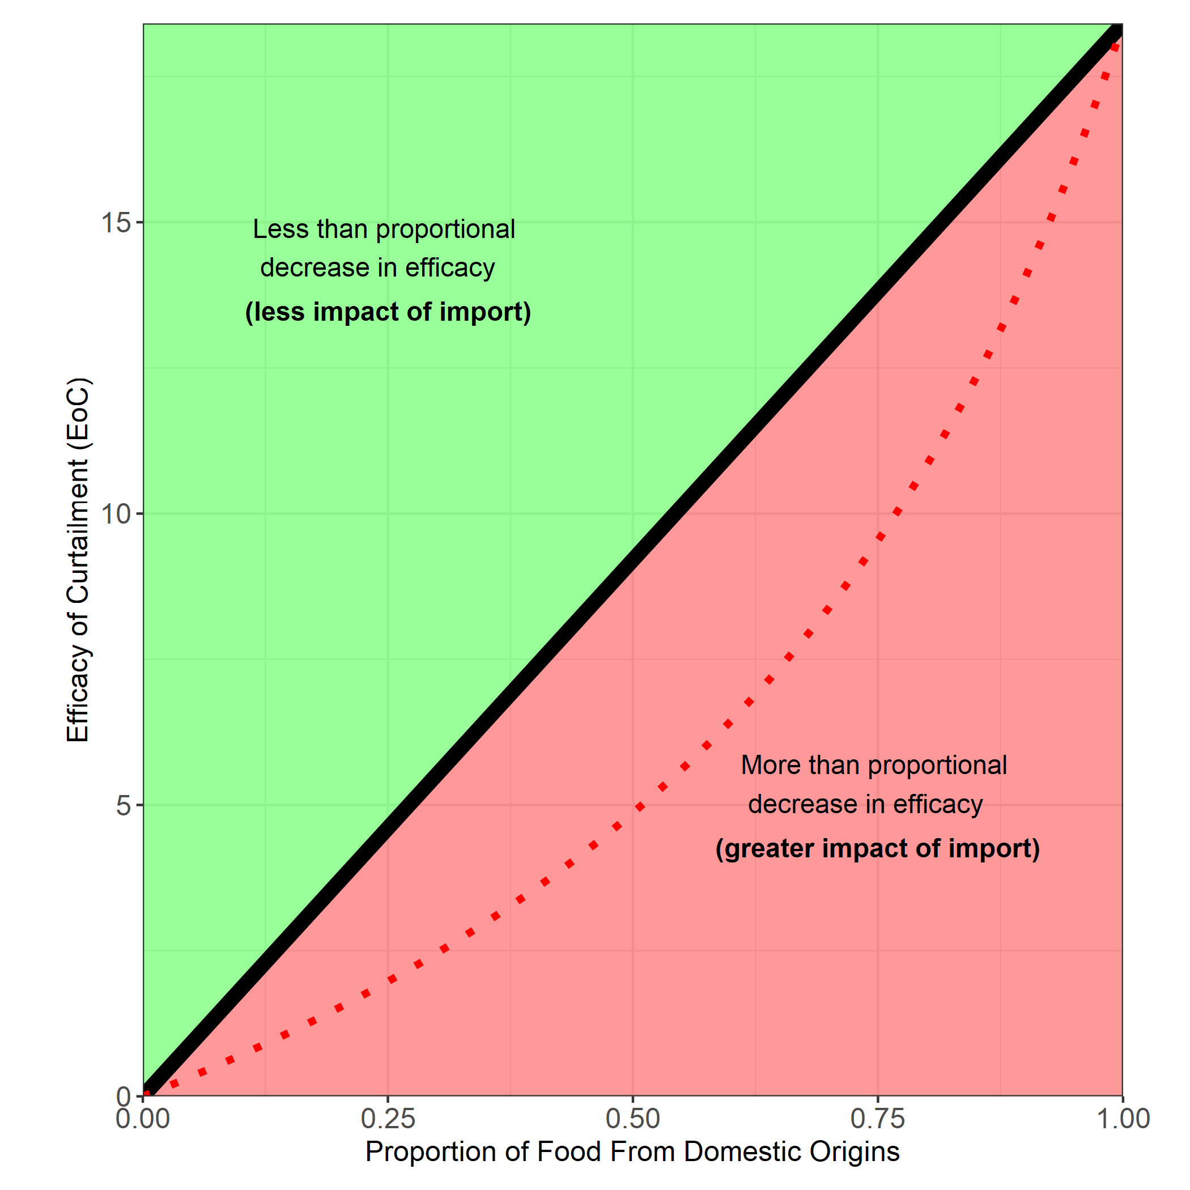
Results – Part 2 Effect of Changing Import
We can assess the effect of changing ψ – the proportion of UK food usage from domestic sources.
Changing amount we import
This allows us to identify if changing import affects the Efficacy of Curtailment (EoC)

Slide 16
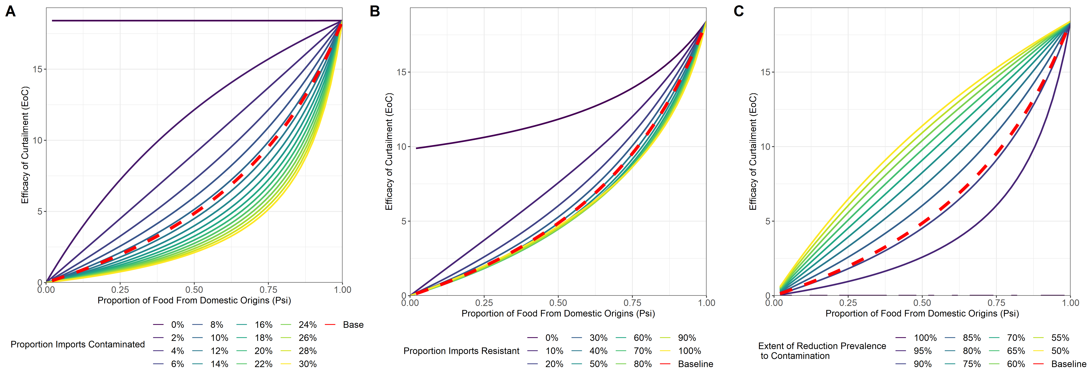
Results – Part 2 Effect of Import
Assess the effect of altering import parameters on the relationship between the proportion of UK food usage from domestic sources (ψ) and the efficacy of curtailment (EoC)
Alterations to parameters occur uniformly across all importing countries
Notes:
There may be other parameters that causes the relationship to “drop” intot he red zone – but for import by far the most important one is the contamiantion parameter
Decreasing the reduction in the drop from prevalence to contamination (how effective biosecurity interventions -

Slide 17
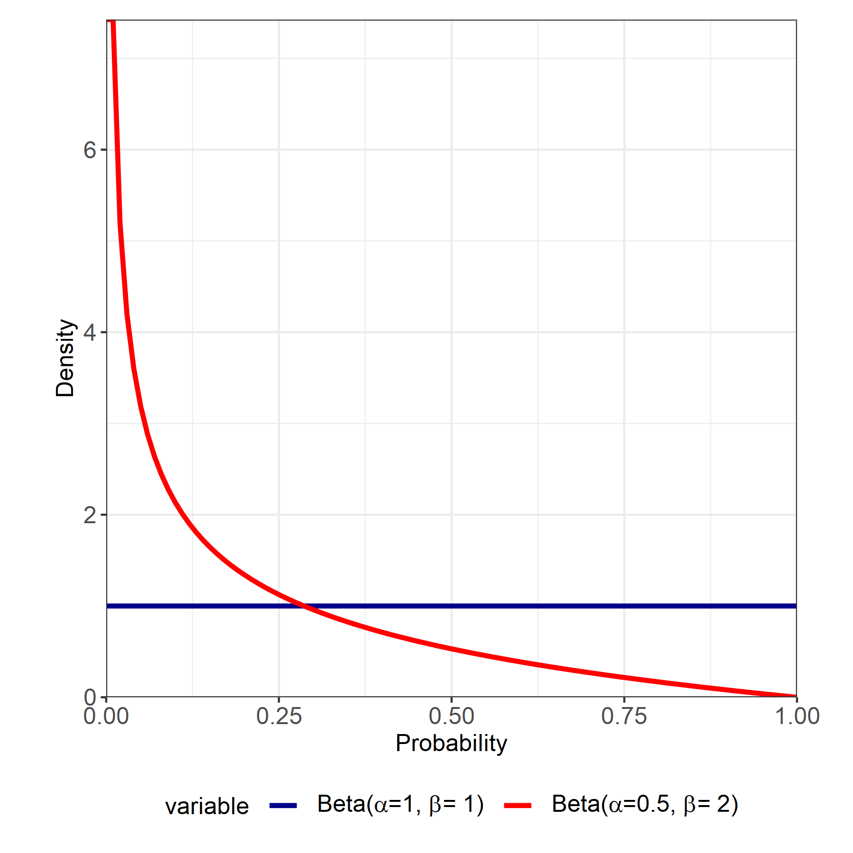
Results – Part 2 Exploring Heterogeneity
We show the average level of contamination is important in determining what happens to the EoC when imports are increased
How does heterogeneity in the relative contribution among importing countries affect the relationship between import and EoC?
We draw the values from two different beta distributions
Uniform – imports are spread across different countries equally
Skewed – imports are concentrated from a small number of locations
Country | NED | IRE | GER | FRA | SPA | ITA | BEL | POL | DEN | nEU
Share | 10% | 10% | 10% | 10% | 10% | 10% | 10% | 10% | 10% | 10%
Country | NED | IRE | GER | FRA | SPA | ITA | BEL | POL | DEN | nEU
Share | 40% | 30% | 5% | 5% | 5% | 5% | 4% | 4% | 1% | 10%

Slide 18
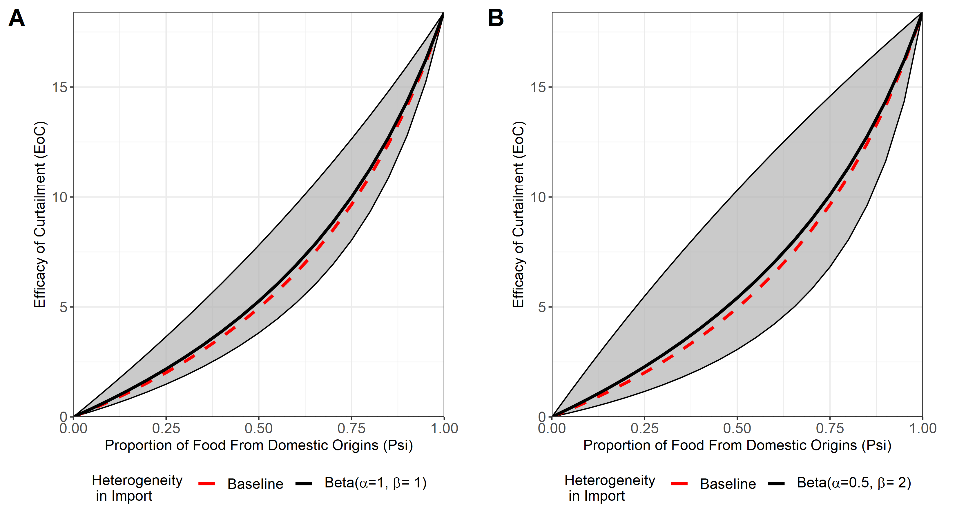
Results – Part 2 Exploring Heterogeneity
We sample the Share_{Imp} parameters for importing countries from the two sampling distributions 1000 times…
e.g: Overall share of France import…
(1-ψ) * Share_{Imp}(Fra)
Increased heterogeneity in “who” you import from, may increase the level of uncertainty in what happens to the efficacy of your intervention (EoC) when altering levels of food importation.
Uniform Share_{Imp} Sampling
“Skewed” Share_{Imp} Sampling

Slide 19
Interim Conclusion – Part 2
Under baseline UK parameters, decreasing the proportion of food products from domestic sources will result in a greater than proportional decrease in the efficacy of livestock antibiotic curtailment (red zone).
The average level of contamination and resistance has a strong impact on the relationship between import and EoC.
To safely increase the proportion of food products from imported sources, the average level of contamination on imported food products must be reduced to low levels (0-2%), resulting in a less than proportional decrease in efficacy of livestock antibiotic curtailment.
Heterogeneity in trading partners does not change the average effect of import on EoC – but increases the level of uncertainty in the relationship.

Slide 20
Overall Conclusions
Import of food products can reduce the efficacy of local one health AMR interventions such as livestock antibiotic curtailment.
The extent of contamination on imported food products influences how strongly import affects local interventions.
Heterogeneity in who we import from does not affect the average effect of import on local interventions, but will increase the level of uncertainty.
Policy Implications
Reductions to livestock resistance can be offset by influences from other locations.
To ensure that one health interventions are not affected by import – systematic efforts are needed to reduce the level of contamination/resistance in livestock across ALL countries rather than changing WHO we import from.

Slide 21





Acknowledgements
Many Thanks to:
University of Edinburgh
Prof Mark Woolhouse
Dr Bram van Bunnik
Prof Dan Nussey
Epigroup
Technical University of Denmark (DTU)
Håkan Vigre
Frank Aarestrup

Slide 22
What happens with the baseline model with different psi

Slide 23
Methods – Datasets: Specifics
UK Specific Parameterisation
Parameterise the extent of contamination and resistance found on UK livestock/Humans.
Data taken from epidemiological studies and ECDC data.
η parameter calculated as reduction in prevalence from Salmonella caecum prevalence to the proportion of pig carcass swabs positive for Salmonella.
General Resistance/Usage Dataset
Parameterise the relationship between livestock antibiotic usage and resistance.
ECDC and EFSA data on livestock ampicillin sales and ampicillin resistance in pigs from different EU countries
Stratified by years (temporal data represents single data points).
EFSA antibiotic sales data standardised to pig sales/usage using pig population correction unit calculations
Import Parameterisation
Parameterise the contamination and resistance on imported food products for different importing countries
Determine the % share of each importing country to the UKs total food supply (ψ).
Requires adjusting according to livestock food product modelled.
Resistance data taken from 400cm² swabs on carcasses only.

Slide 24
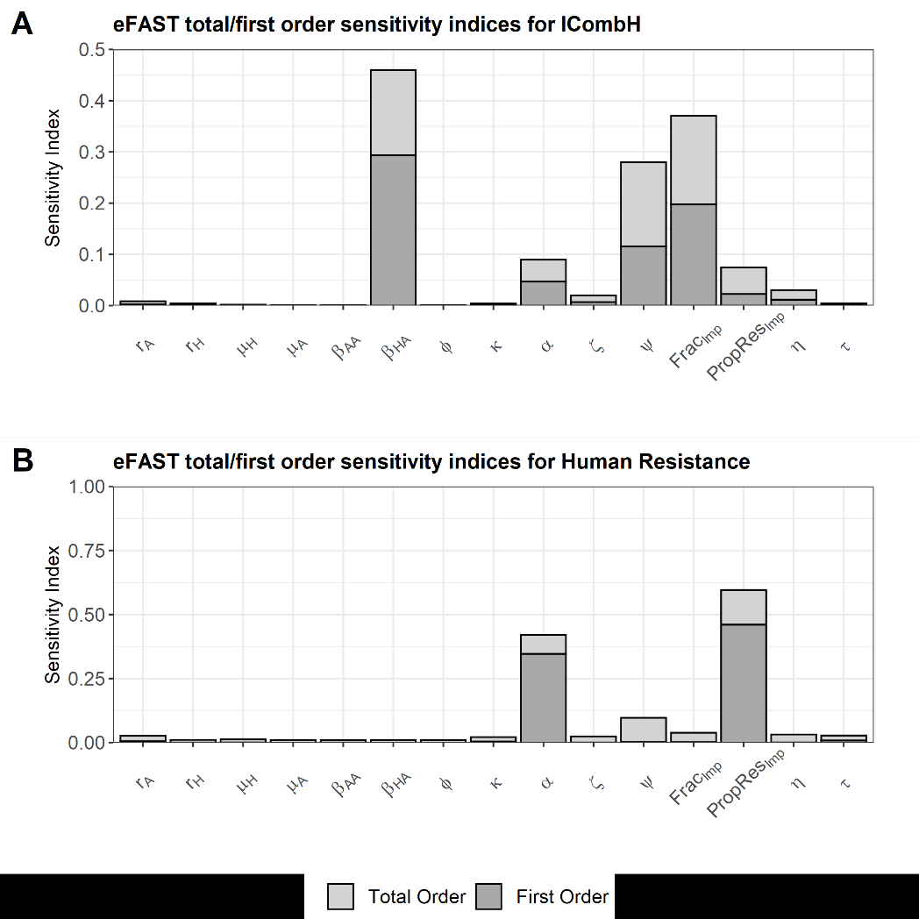

Slide 25
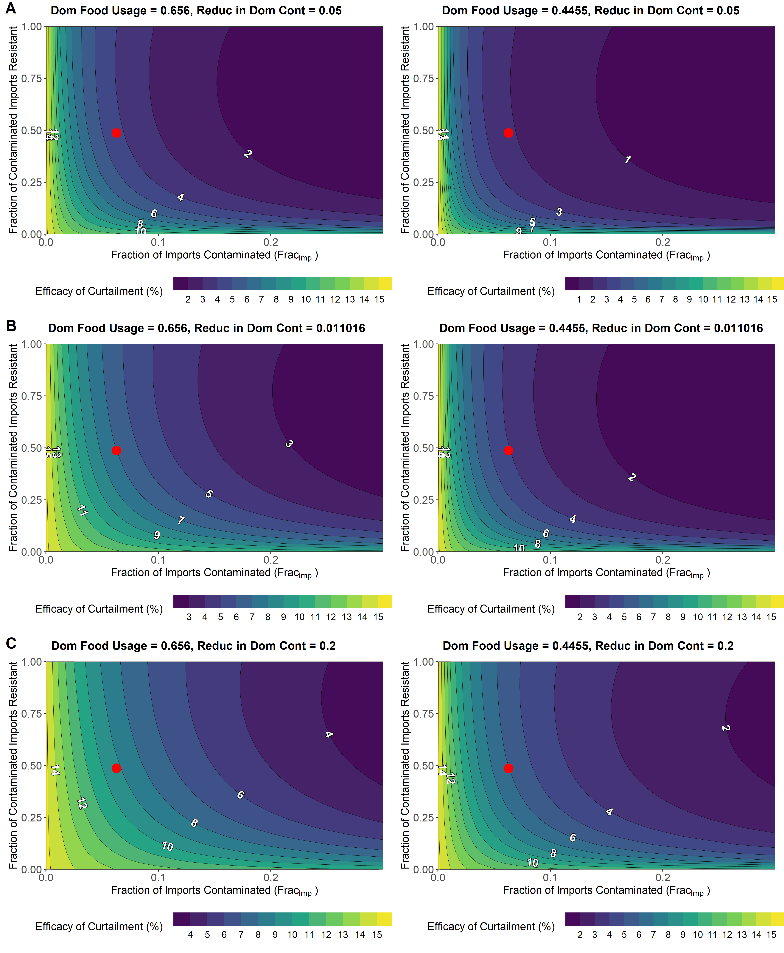
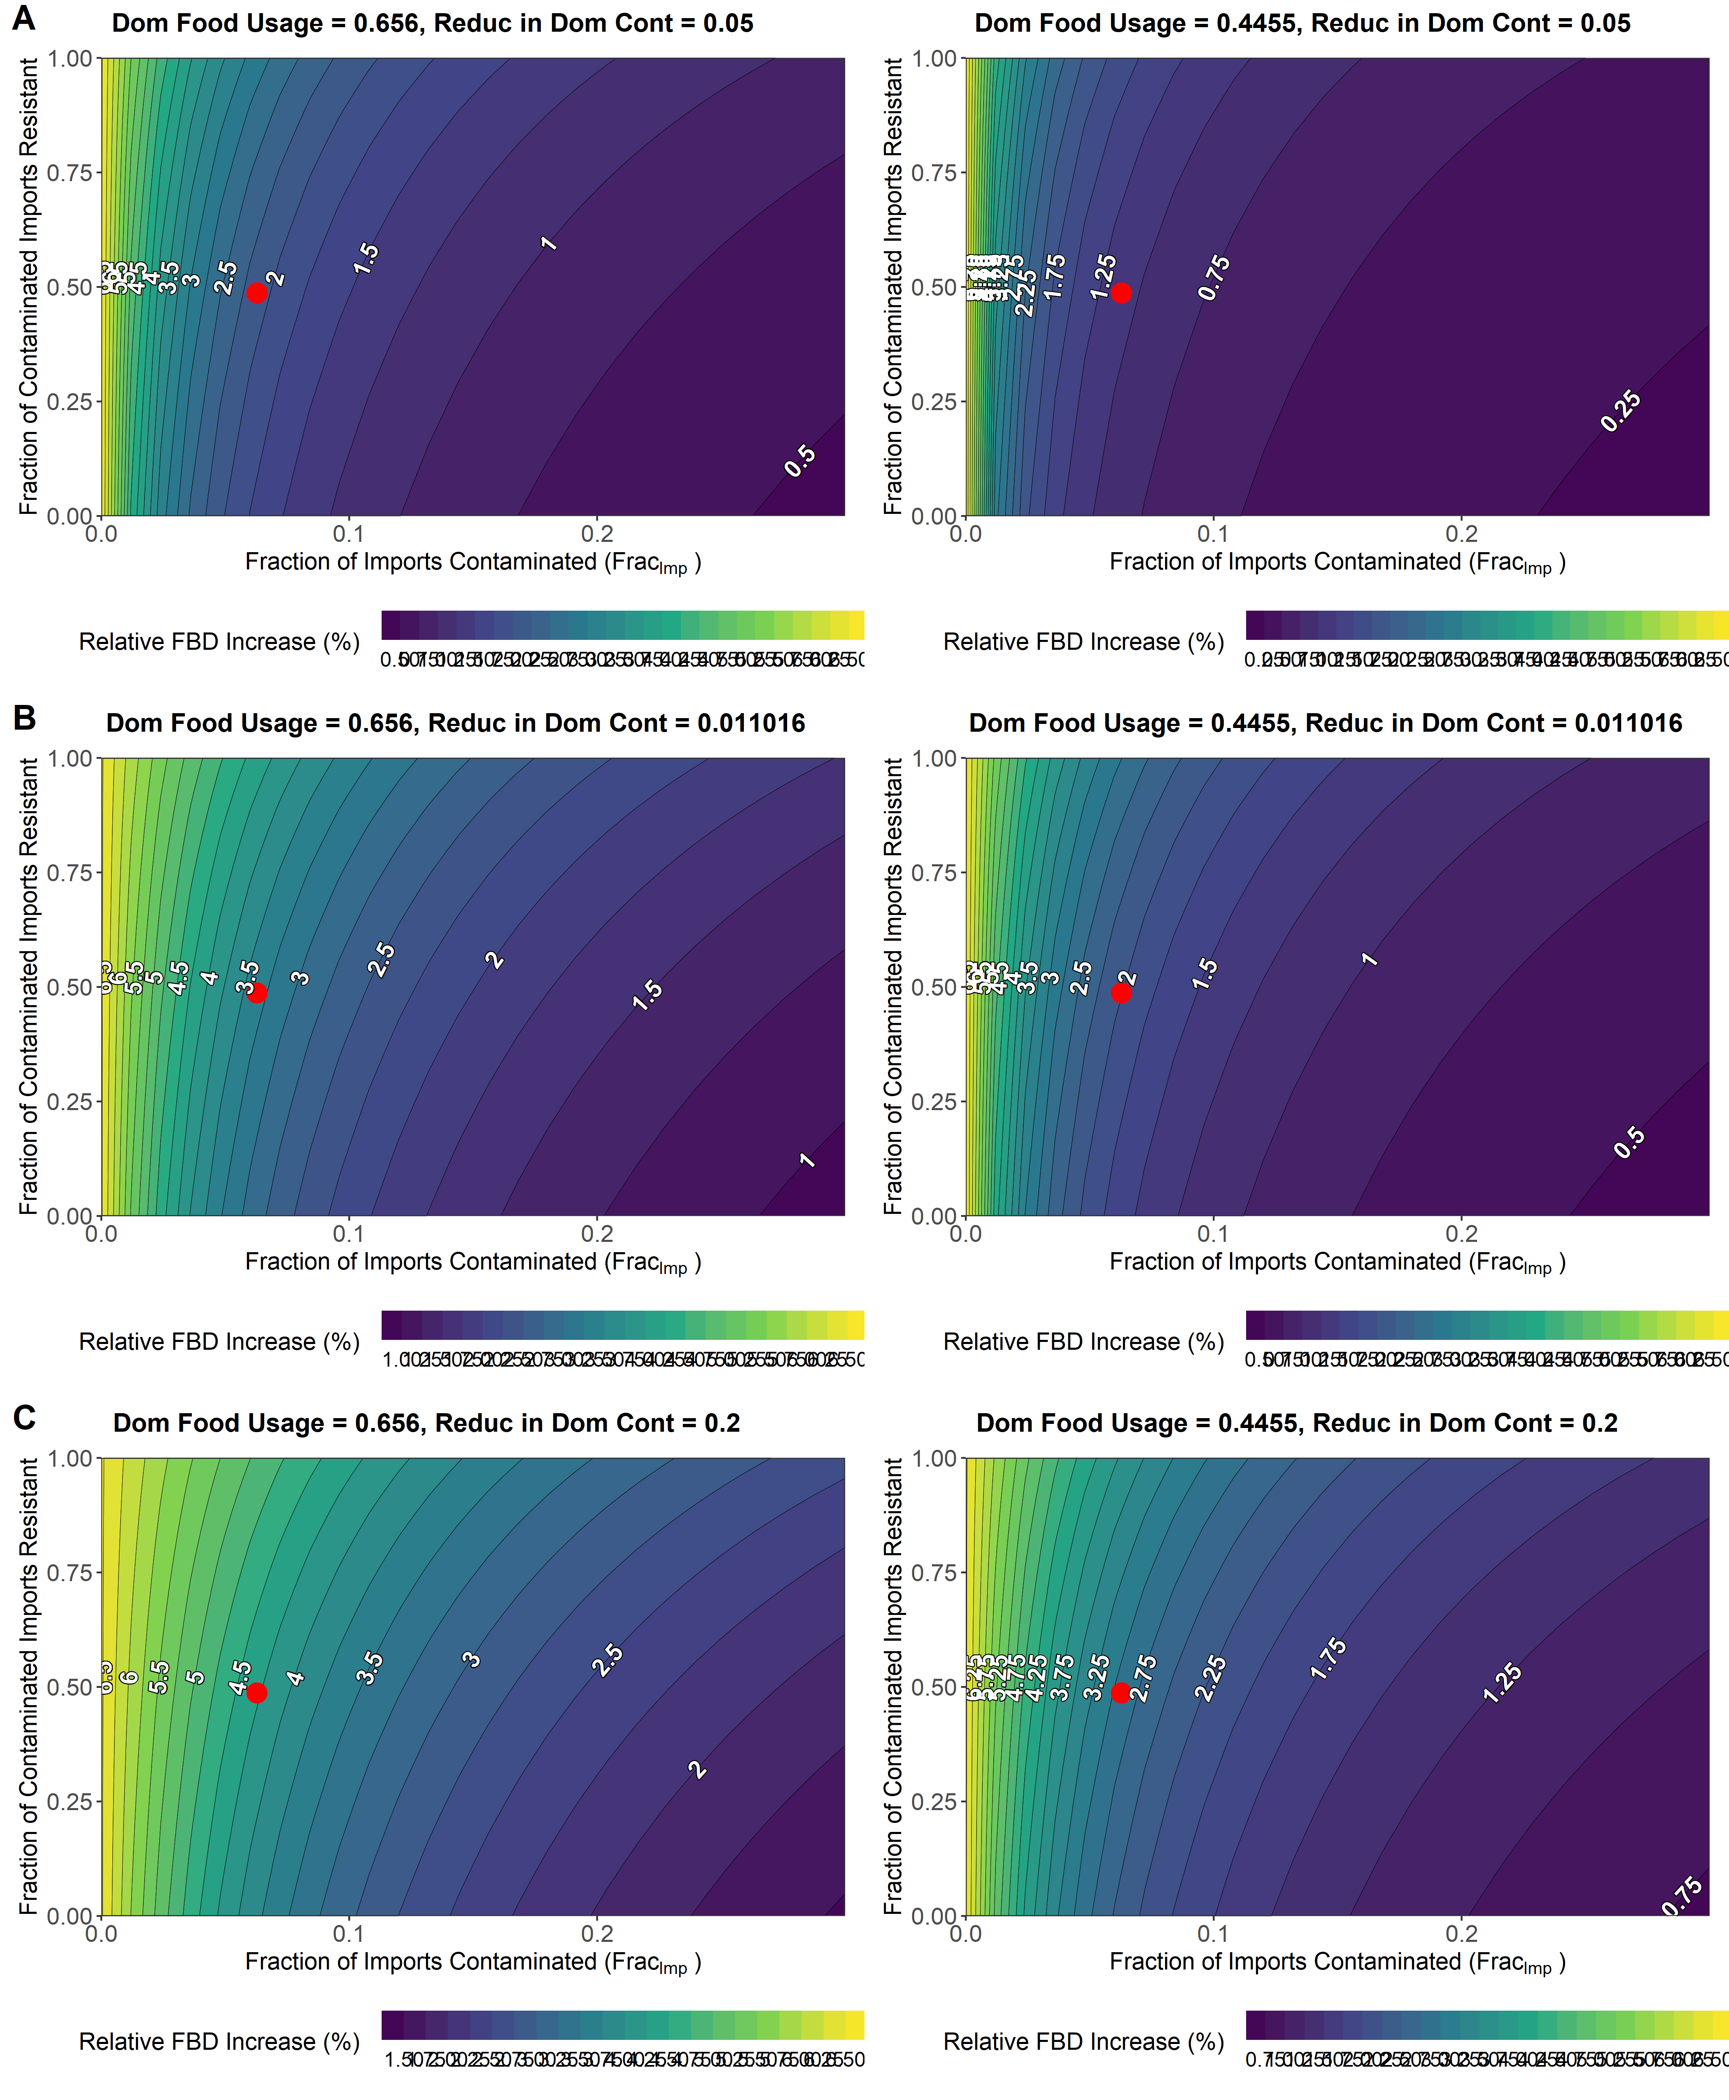
Relative Change in Resistance
Relative Change in FBD

